Slide 1

Bring Your Best Buds:
A Cannabis Health Presentation
By: Adam Read & Jenna Pinkney

Slide 2
What is Marijuana?
Marijuana is a product of the plant Cannabis sativa
A psychoactive substance - drug that affects your mind
Main Active Chemicals:
THC (delta-9-tetrahydrocabbinol) – alters the mind and gives users a “high”
CBD (cannabidiol) – currently being studied and used for medical purposes
What does it look like:
Consists of dried flowers, fruiting tops and leaves from the marijuana plant
Greenish or brownish colour (most common)

Slide 3
Other Names
Cannabis
Bud
Chronic
Dab
Dope
Ganja
Grass
Green
Hash
Herb
Loud
Mary Jane (MJ)
Pot
Reefer
Skunk
Trees
Wax
Weed

Slide 4
Why People May Use Cannabis
To…
relax
have fun
alter their perspective
fit in
experiment
try something new
be more social and energized
become more focused, creative or productive

Slide 5
Recreational vs. Medical Cannabis
Medical cannabis is used to alleviate symptoms of certain conditions and diseases
Medical cannabis is usually higher in CBD
Recreational cannabis is usually higher in THC (‘high’)
Cannabis for medicinal use is prescribed by a medical practitioner

Slide 6
Intended Effects
To cause effects on the mind/body, including:
Feeling high (euphoria)
A sense of well-being
Relaxation
Heightened sensory experiences (sight, taste, smell, sound)
Increased appetite

Slide 7
Side Effects
An inability to concentrate
Memory problems
Anxiety, panic or paranoia
Disorganized thoughts
Dizziness or hallucinations
Reduced reaction time
Sleepiness

Slide 8
Health Risks
Syncope
Bronchitis
Lung infections
Chronic (long-term) cough
Increased mucus buildup in the chest

Slide 9
cont’d
Consumption before age 25 - risks to brain development, especially in strains with high THC potency and/or if consumption is frequent
Possible addiction (Health Canada estimates a 9% addiction rate)
Exposure to harmful second-hand smoke
Risk of harm to concentration, decision making ability, intelligence and memory
Heavy use of cannabis or mixing with alcohol and other drugs may lead to an acute case of psychosis

Slide 10
Factors Affecting The Body’s Response to THC
THC content
Method of consumption
Amount of consumption
Age
Health history
Previous experience with cannabis

Slide 11
Methods of Consumption
Inhalation - burning or vaporization of dry, ground cannabis flowers (e.g. joints, blunts, pipes, bong)
Ingestion - eating or drinking cannabis (e.g. capsules, oils or edible products)
Topical
Sublingual (e.g. tinctures and sprays)

Slide 12
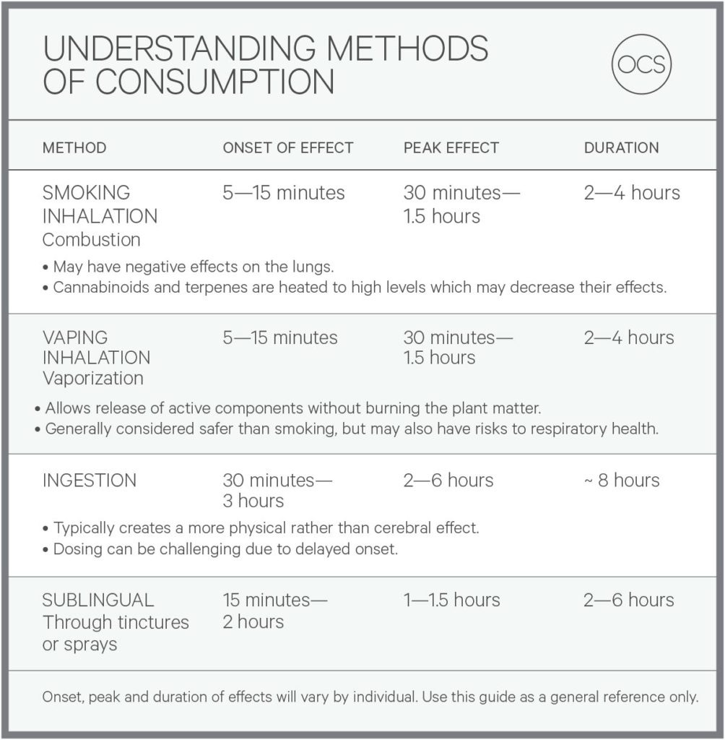

Slide 13
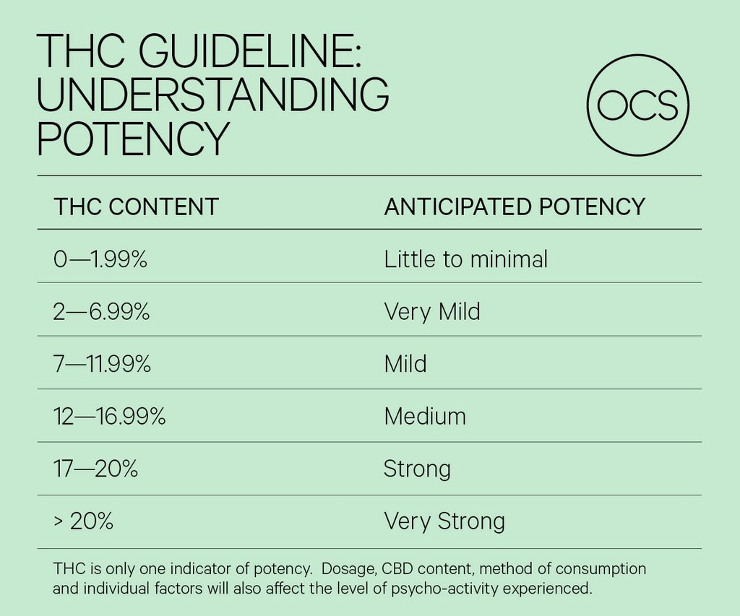

Slide 14
Health & Safety Tips
Cannabis use before age 25 may affect brain development
Never drive after or while consuming cannabis
Avoid cannabis if you are higher risk for mental health issues
Avoid cannabis use while pregnant or breastfeeding
Avoid mixing alcohol or tobacco with cannabis
Keep cannabis out of reach of children
Do not use cannabis with a child in the home
Do not use synthetic cannabis (K2, spice, salvia)
Avoid holding cannabis smoke in your lungs

Slide 15
Implications for Sports
Policies related to cannabis use in university sports remain UNCHANGED according to the Canadian Centre for Ethics in Sport and World Anti-Doping Agency
Cannabis is still a prohibited substance on the WADA list for student athletes and will result in a positive doping violation

Slide 16
Additional Resources
http://ocslearn.ca
http://www.uwindsor.ca/recreationalcannabis/
http://www.uwindsor.ca/recreationalcannabis/sites/uwindsor.ca.recreationalcannabis/files/cannabis_strategy_-_final.pdf
https://www.canada.ca/en/health-canada/services/drugs-medication/cannabis/health-effects/effects.html

Slide 17
Questions?
iscnurse@uwindsor.ca

Slide 18
Thank You!

